Slide 1
Modern Statistics for Modern Biology
Susand Holmes & Wolfgang Huber
Chapter 1 background material

Slide 2
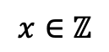
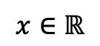
Mathematical notation for different types of numbers
Real numbers are found on the number line:
$$x∈ℝ$$
means:
x belongs to the set of real numbers
(x is a real number)
$$x∈ℤ$$
means:
x is an integer

Slide 3
Mathematical functions
f(x) is read as “the function f of x”
Can think of it like a “black box” where you put in an input value, x, the function
does something to it, and get out an output value, f(x).
x
f()
f(x)
You may or may not know exactly what the function is, i.e. have an equation for it. e.g. a linear function has the form:
f(x) = y = a*x+b
a and b are the parameters of the function. x and y are variables.
The parameters define one particular line. Specific x and y combinations define points along that line.

Slide 4
Inverse functions
If:
f(x) = y
g(y) = x
Then f(x) is an inverse function of g(x) (and visa versa)
Basically one function “undoes” the action of the other one.
x
f()
f(x)
g()
x

Slide 5
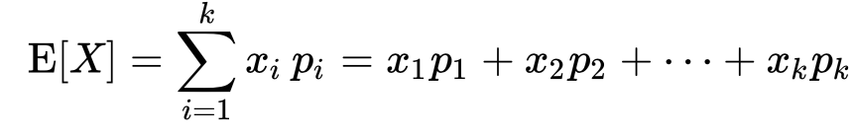
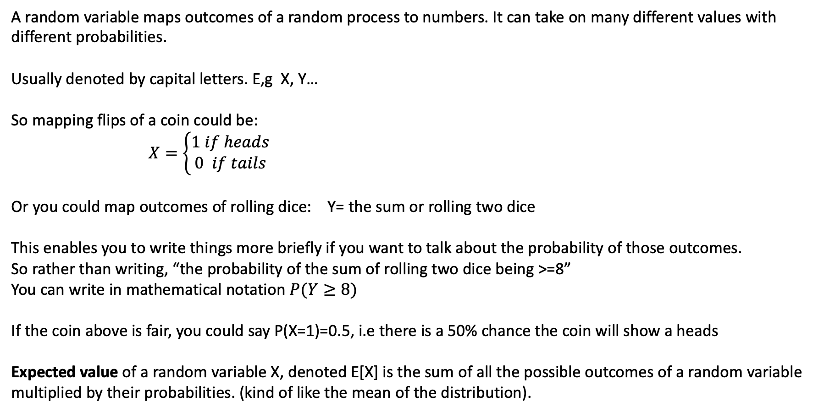
Random variables
A random variable maps outcomes of a random process to numbers. It can take on many different values with different probabilities.
Usually denoted by capital letters. E,g X, Y…
So mapping flips of a coin could be:
$X=\left\{\begin{aligned}1 if heads \\ 0 if tails\end{aligned}\right.$
Or you could map outcomes of rolling dice: Y= the sum or rolling two dice
This enables you to write things more briefly if you want to talk about the probability of those outcomes.
So rather than writing, “the probability of the sum of rolling two dice being >=8”
You can write in mathematical notation $P(Y≥8)$
If the coin above is fair, you could say P(X=1)=0.5, i.e there is a 50% chance the coin will show a heads
Expected value of a random variable X, denoted E[X] is the sum of all the possible outcomes of a random variable multiplied by their probabilities. (kind of like the mean of the distribution).

Slide 6
Types of variables
R: type:
typeof(x)
as.factor(x) factor
as.logical(x) logical
(TRUE/FALSE)
(0/1)
Genotypes: aa, Aa, AA
as.factor(x) factor
as.integer(x) integer
1,2,3,-5…
as.numeric(x) double
3.2, 3e-2, 0.03

Slide 7
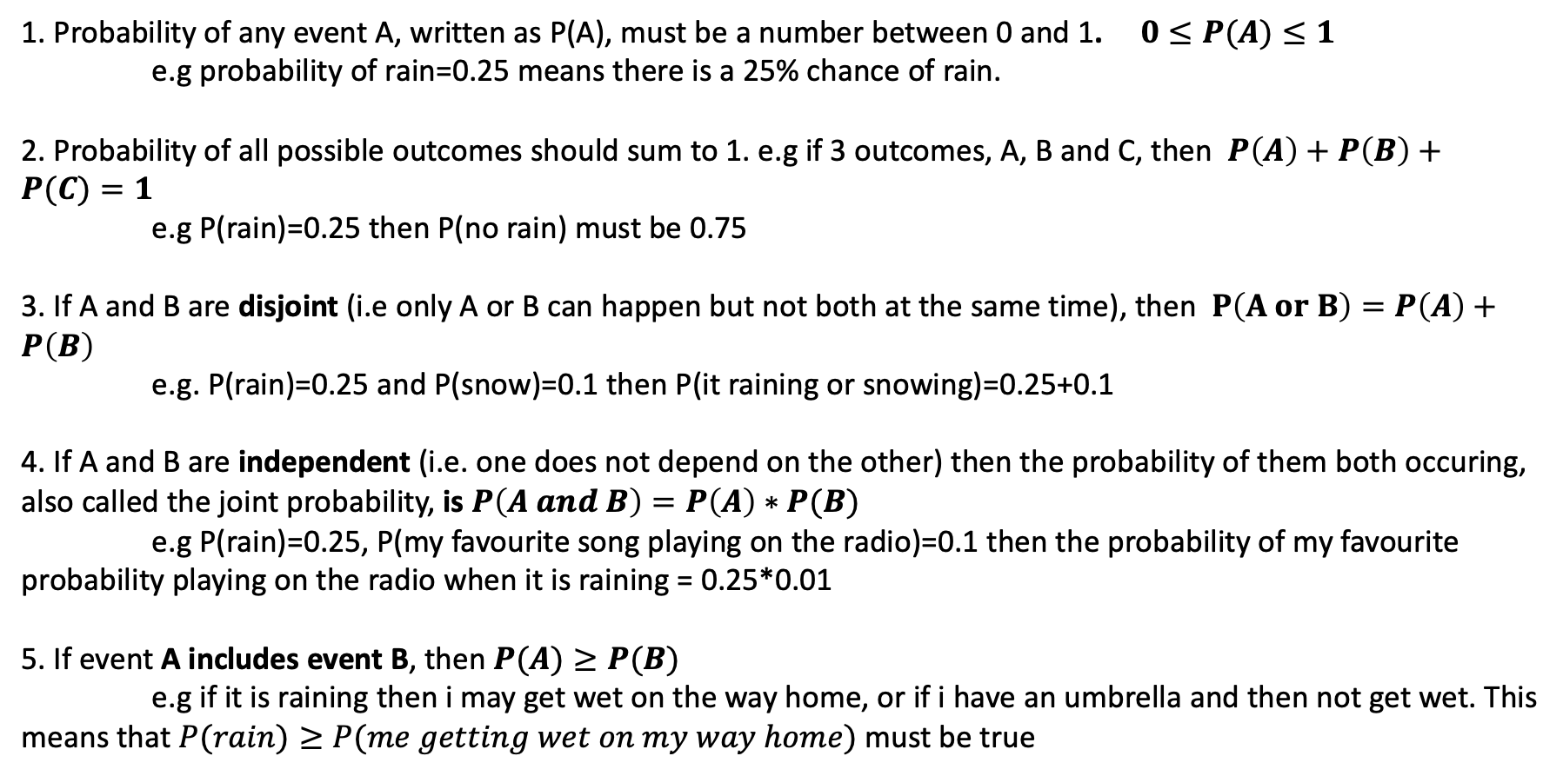
Probability rules
1. Probability of any event A, written as P(A), must be a number between 0 and 1. $0≤P(A)≤1$
e.g probability of rain=0.25 means there is a 25% chance of rain.
2. Probability of all possible outcomes should sum to 1. e.g if 3 outcomes, A, B and C, then $P\left(A\right)+P\left(B\right)+P(C)=1$
e.g P(rain)=0.25 then P(no rain) must be 0.75
3. If A and B are disjoint (i.e only A or B can happen but not both at the same time), then $P\left(A or B\right)=P\left(A\right)+P\left(B\right)$
e.g. P(rain)=0.25 and P(snow)=0.1 then P(it raining or snowing)=0.25+0.1
4. If A and B are independent (i.e. one does not depend on the other) then the probability of them both occuring, also called the joint probability, is $P\left(A and B\right)=P\left(A\right)∗P(B)$
e.g P(rain)=0.25, P(my favourite song playing on the radio)=0.1 then the probability of my favourite probability playing on the radio when it is raining = 0.25*0.01
5. If event A includes event B, then $P(A)≥P(B)$
e.g if it is raining then i may get wet on the way home, or if i have an umbrella and then not get wet. This means that $P(rain)≥P(me getting wet on my way home)$ must be true

Slide 8
Describing probability distributions
PDF: probability density function
CDF: Cumulative distribution function
(the integral of the area under the curver in the PDF)

Slide 9
PDF: probability density function
CDF: Cumulative distribution function
What is probability of getting a value <= 1 (grey area)?
Read off value of CDF at 1 (~0.84)

Slide 10
PDF: probability density function
CDF: Cumulative distribution function
What is probability of getting a value >= 1 (white area)?
Read off value of 1-(CDF at 1) 1-0.84=0.26

Slide 11
R distribution functions:
NOTE: for continuous variables (normal distrubtion) you have DENSITY functions
For discrete variables (poisson and binomial distributions) you have MASS functions
normal poisson binomial
Probability density/mass function (PDF/PMF) dnorm dpois dbinom
Cumulative distribution (CDF) pnorm ppois pbionm
Random generation rnorm rpois rbinom
Quantile function qnorm qpois qbinom
Probabilty density/mass function: What is the probability of getting that value when sampling (see previous slide)
Cumulative density/mass function: What is the probability of getting values less or equal to
that number when sampling e.g. pnorm(1)=0.84 (see previos slide)
Random generation: Randomly samples from that particular random distribution
Quantile function: the inverse of CDF/CMF: e.g. qnorm(0.84)=1

Slide 12
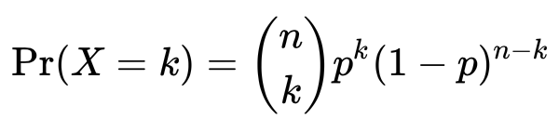
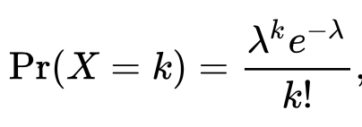
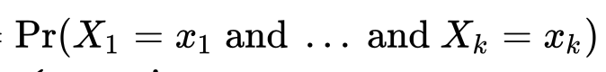
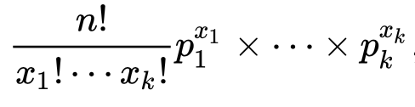
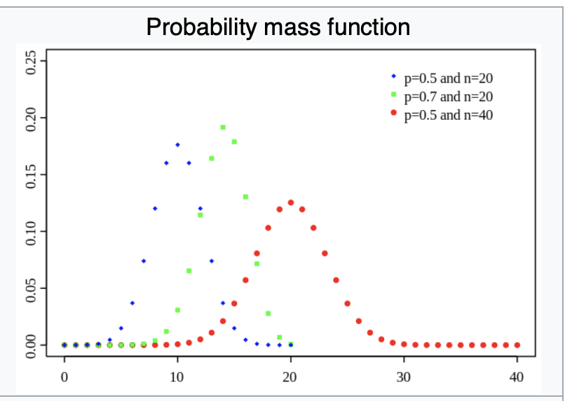
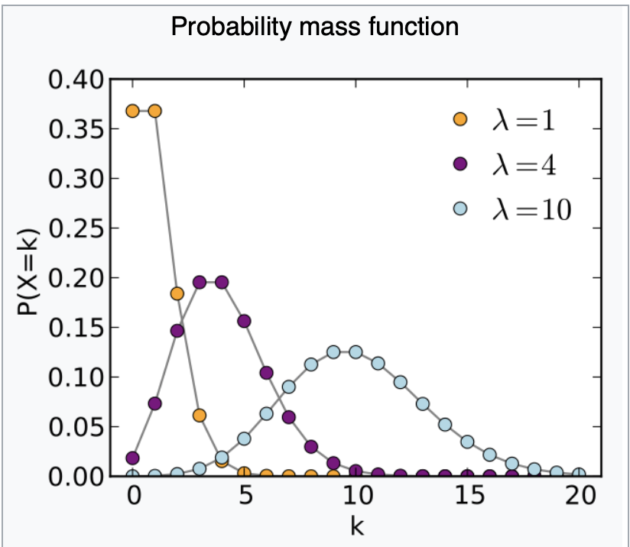
Some discrete probability distributions:
Binomial
Models number of successes in a sequence of n independent experiments (e.g. number of heads in 100 coin flips)
Parameters:
n is number of experiments
p is probability of success in each experiment
When n=1 this is also called the Bernoulli distribution
Poisson
Models probability of a given number of independent events occurring in a fixed interval of time or space. E.g number of pieces of mail you receive in a day
Parameter:
Lambda is the rate of the event occurring (e.g 4 pieces of mail per day)
Can approximate binomial when n>=100 , p<=0.01, lambda<20
Multinomial
Models number of successes in k categories in n independent trials.
e.g. the number of times you get each face of a 6-sided die in 20 rolls
Parameters:
k number of categories
n total number of successes
p_{k} probability of success in each category
Generalisation of binomial which only has two categories
=

Slide 13
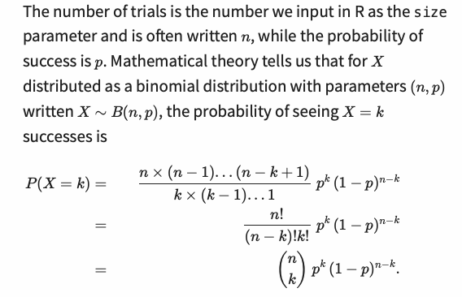
Binomial distribution
“n factorial” e.g. 3!=3*2*1
“n choose k” is number of ways you can pick 3 successes from n trials

Slide 14
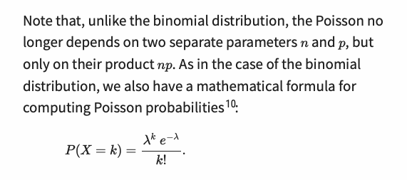
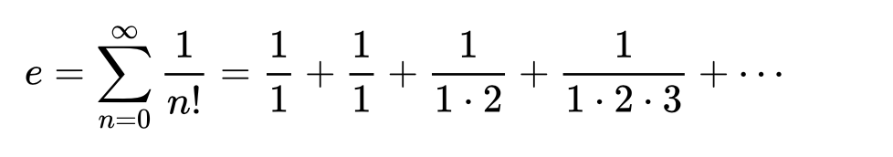
Poisson distribution
Its value is:
e is “Euler’s number”, a
sspecial number in
mathematics:
2.71828

Slide 15
Binomial distribution with large n and small p tends to poisson distribution
Some links showing how the poisson distribution can be derived from the binomial (requires some calculus):
https://www.youtube.com/watch?v=ceOwlHnVCqo
https://medium.com/@andrew.chamberlain/deriving-the-poisson-distribution-from-the-binomial-distribution-840cc1668239

Slide 16
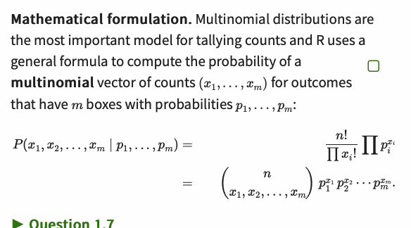
Multinomial distribution

Slide 17
Basic stats concepts that are important to understand

Slide 18
Degrees of freedom
The number of independent pieces of information that go into the estimate of a parameter
Suppose you draw a sample from a population and get the following values: 7, 6, 3, 9, 4
And you calculate a parameter, like the mean: avr=5.8
Degrees of freedom mean how many of these pieces of information are independant? In this case it is the number of measurements minus 1 (n-1)
So if you know 4 of the measurements (7,6,3,9,?) and the mean(5.8), you can calculate the last measurement (5.8*5-7-6-3-9=4)
However if you only know 3 of the measurements (7,6,3,?,?) there are many combinations that could give you the same mean, e.g
7,6,3,8,5
7,6,3,2,11
…
So the n-1th number is independant of the n^{th} number, so you have n-1 degrees of freedom in this case.

Slide 19
P values
What does it mean that your results is significant at p=0.05 level?
Does it mean we are 95% sure that the alternative hypothesis it true?
NO!!!!!!
It means: Under the assumption of the NULL hypothesis being TRUE, if you ran this experiment many many times, you would expect, on average, 5% of the results to be as extreme or more extreme as the result you obtained.
In other words, even if there is NO TRUE DIFFERENCE between your sample and the expected values, you would still get this result 5% of the time…
We know nothing about the distribution of the statistic if the alternative hypothesis is true, all we can say is that our sample is unlikely to come from the null distribution (but still could, 5% of the time).

Slide 20
Multiple testing problem
If you run the same experiment 20,000 times, with a p=0.05 significance threshold, you would expect 5% of the results to be positive, i.e. 1000 positive results even if there is no real underlying difference!!
This is why in genomics, when you do RNAseq (with 20,000 genes in the genome), you cannot use a simple p-value, because many genes would come out as significant.
So you need a corrected p-value
The intuitively simplest correction is called the Bonferroni correction, where you simply divide the threshold p value by the number of experiments 0.05/20000=0.0000025 and use this as your new threshold for statistical significance.
The bonferroni correction is usually too harsh, so people often use the False Discovery Rate (FDR)

Slide 21
Effect size
Comparing heights of two groups of 1000 people:
Very significant difference p=0.00000006
But effect size is tiny. Mean group1: 160cm, mean group2: 161cm. Do we really care about such a small difference?

Slide 22
Power
Power is the probability of detecting an effect when it is really there, also known as sensitivity or true positive rate (TPR)
One often sets power at 0.8
In R one can calculate power for certain tests using special functions, e.g. power.chisq.test from DescTools

Slide 23
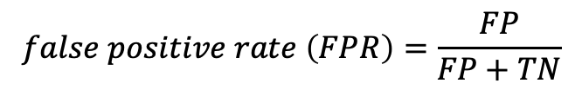


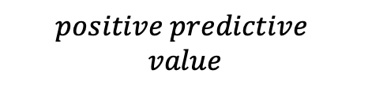
Confusion matrix comparing predictions and ground truth (reality)
True positive rate (TPR) =
(1-β) = power
β
⍺
$$PPV$$
$$positive predictive$$
$$value$$
$$false positive rate \left(FPR\right)=\frac{FP}{FP+TN}$$
$false discovery rate \left(FDR\right)=1−PPV=\frac{FP}{FP+TP}=\frac{FP}{positive calls}$

Slide 24
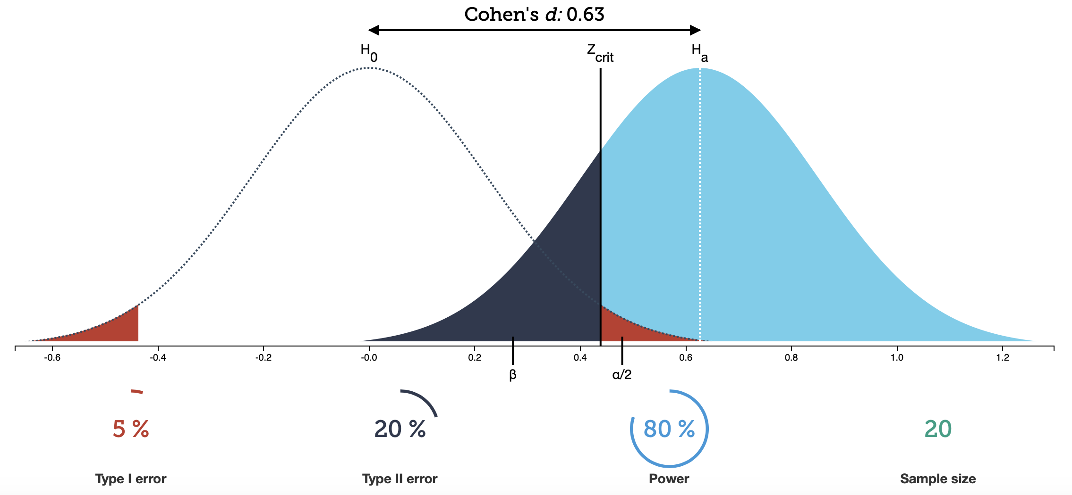
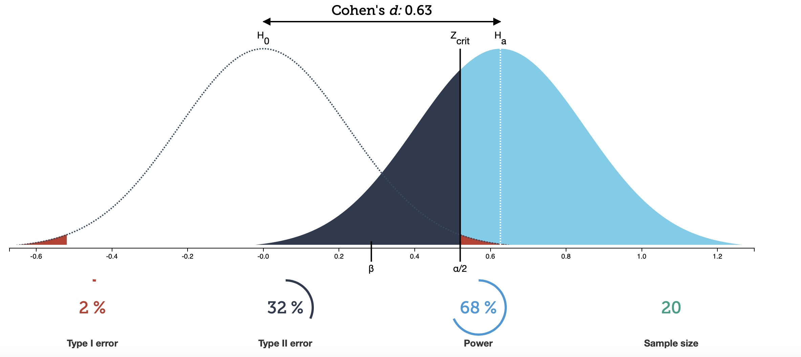
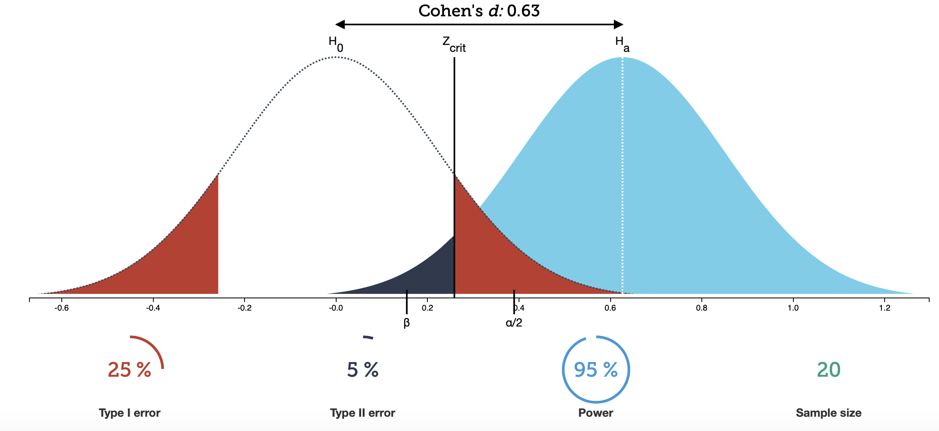
Power vs significance trade-off
Lower significance threshold
Lower power
More power
higher significance threshold
See https://rpsychologist.com/d3/NHST/ for interactive display of interplay of: population size, effect size, significance and power

